Slide 1
Disclaimer
THIS PRESENTATION IS NOT AN OFFER OR SOLICITATION OF AN OFFER TO BUY OR SELL ANY SECURITIES OR ANY INVESTMENT.
•This presentation has been prepared by Dawood Lawrencepur Limited (“DLL”) solely for information purposes. No representation or warranty expressor implied is made thereto, and no reliance should be placed on, the fairness, accuracy, sufficiency, completeness or correctness of the information or any opinion contained herein, or any opinion rendered thereto. The information contained in this presentation should be considered in the context of the circumstances prevailing at the time and will not be updated to reflect any developments that may occur after the date of the presentation. Neither DLL nor any of its respective subsidiaries, affiliates, officials, advisors, associates, employees or any person working for, under or on behalf, shall have any responsibility and/or liability of any nature whatsoever (in contract or otherwise) for any loss whatsoever arising from any use of this presentation or its contents or otherwise arising in connection with this presentation.
•This presentation does not constitute or form part of a prospectus, offering circular or offering memorandum or an offer, solicitation, invitation or recommendation to purchase or subscribe for any securities and no part of it shall form the basis of, or be relied upon in connection with, or act as any inducement to enter into any arrangement, agreement, contract, commitment or investment decision in relation to any securities. This presentation shall not at all be intended to provide any disclosure upon which an investment decision could be made. No money, securities or other consideration is being solicited, and, if sent in response to this presentation or the information contained herein, will not be accepted.
•The presentation may contain statements that reflect DLL’s own beliefs and expectations about the future. These forward-looking statements are based on a number of assumptions about the future, which are beyond DLL’s control. Such forward-looking statements represent, in each case, only one of many possible scenarios and should not be viewed as the most likely or standard scenario. Such forward looking statements are subject to certain risks and uncertainties that could cause actual results to differ materially from those contemplated by the relevant forward-looking statements. DLL does not undertake any obligation to update any forward-looking statements to reflect events that occur or circumstances that arise after the date of this presentation and it does not make any representation, warranty (whether express or implied) or prediction that the results anticipated by such forward-looking statements will be achieved. In addition, past performance should not be taken as an indication or guarantee of future results.
•Certain data in this presentation was obtained from various external data sources that DLL believes to its knowledge, information and belief to be reliable, but DLL has not verified such data with independent sources and there can be no assurance, representation or warranty as to the accuracy, sufficiency, correctness or completeness of the included data. Accordingly, DLL makes no assurance, representation or warranty as to the accuracy, sufficiency, correctness or completeness of that data, and such data involves risks and uncertainties and is subject to change based on various factors.
•By attending this presentation, you are agreeing to be bound by the foregoing limitations.

Slide 2
Dawood Lawrencepur Limited
Analyst Briefing – Q3 2023

Slide 3
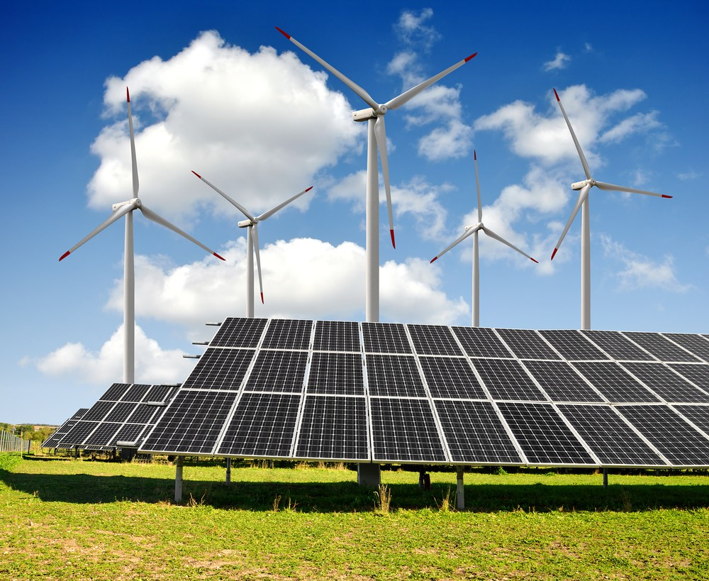
Business Interests
Power generation
Solar power
Associate – 16.19%
Wind power

Slide 4
Consolidated Performance (9M 2023)
The current year has posed unforeseen challenges for the solar business. The decline in revenue is primarily attributed to external factors such as regulatory uncertainties, market fluctuations, and the global economic landscape. These variables have collectively impacted our ability to maintain previous levels of sales and growth.
Wind business has been on uptrend due to significant increase in tariff vs. 2022.
Owing to higher dividends from associate, the overall profitability for DLL standalone has increased by 159%.
Amounts in PKR Mn unless otherwise stated

Slide 5
Solar Business Performance (9M 2023)
Performance
The Company was able to lock an order intake till the period September 2023 amounting to PKR 2.7 Bn in C&I and PKR 0.6 Bn in Telco amid the prevailing economic crisis in the country.
Major deals secured during this year included Din Textile Mills, Interloop Industrial Park, Ibrahim Fiber Limited, Lucky Pezu Extension, Shahbaz Garments, Indus Motors and Novatex.
Outlook
During the first quarter, The Holding Company resolved to sell the entirety of its stake in REL to Juniper International FZ LLC. Juniper International is well-suited to steward REL, given their portfolio of companies and years of experience and will help REL realize its growth ambitions while taking particular care for capital stewardship and productivity. The transaction is expected to be completed by Q1 next year.
Amounts in PKR Mn unless otherwise stated

Slide 6
Wind Business Performance (9M 2023)
Performance:
Revenue and profitability increased due to higher tariff despite being affected by curtailment and transmission issues during the year 2023.
TGL during the year announced an interim cash dividend for the year ending December 31, 2023, amounting to PKR 150 mn.
Payments from the power purchaser improved compared to the previous year, boosting the cash stream.
Amounts in PKR Mn unless otherwise stated

